Slide 1
Leveraging HR Data
Amanda Loy

Slide 2
INTRODUCTION
In today's dynamic work environment, understanding the value employees place on direct engagement and effective leadership is crucial for fostering a positive and productive workplace. To determine the significance employees attribute to direct interactions and preferred leadership styles, it is essential to gather data through surveys or feedback mechanisms. This presentation will explore the importance of assessing employee preferences and the insights it provides into their satisfaction, performance, and overall organizational success.
Notes:
Understanding the value employees place on direct engagement and preferred leadership styles is vital for creating a thriving workplace. By collecting and analyzing data through surveys, assessments, and feedback mechanisms, organizations can gain valuable insights into employee preferences, enabling them to tailor their engagement strategies and leadership development initiatives. This data-driven approach will help cultivate a culture of open communication, empowerment, and collaboration, resulting in enhanced employee satisfaction, improved performance, and overall organizational success.
The slides will cover information discovered during exploration and how it was applied towards the business question to determine which predictive models were beneficial.

Slide 3
PRIMARY GOALS
Find which factors relate towards attrition
Notes:
To determine which factors relate to attrition, a comprehensive analysis of various variables can be conducted. Some key factors to consider are:
Job Satisfaction: Assessing the level of satisfaction employees have with their job can provide insights into their overall engagement and motivation. Lower job satisfaction may be associated with a higher likelihood of attrition.
Job Involvement: Understanding how involved employees feel in their work and the organization can shed light on their commitment and dedication. Higher levels of job involvement may indicate a lower risk of attrition.
Training Opportunities: Evaluating the availability and effectiveness of training programs provided to employees can reveal their perception of growth and development opportunities. A lack of training or limited professional advancement prospects may contribute to attrition.
Work-Life Balance: Analyzing the balance between work-related responsibilities and personal life can highlight the impact on employee well-being and job retention. Employees experiencing high levels of work-related stress or an imbalance between work and personal life may be more prone to attrition.
Compensation and Benefits: Examining the competitiveness of compensation packages and the availability of desirable benefits can help gauge their influence on attrition. Inadequate compensation or limited benefits may lead to dissatisfaction and increased attrition rates.
Leadership and Management: Assessing the quality of leadership and management practices can provide insights into their impact on employee retention. Poor leadership, lack of communication, or insufficient support from supervisors may contribute to attrition.
Career Growth Opportunities: Investigating the availability of advancement opportunities and clear career paths within the organization can indicate the potential for employee retention. Limited career growth prospects may lead to attrition as employees seek better opportunities elsewhere.
By conducting thorough data analysis, including surveys, interviews, and analyzing historical employee records, organizations can identify the factors that relate to attrition within their specific context. This information can then be used to develop targeted strategies to address these factors and improve employee retention rates.

Slide 4
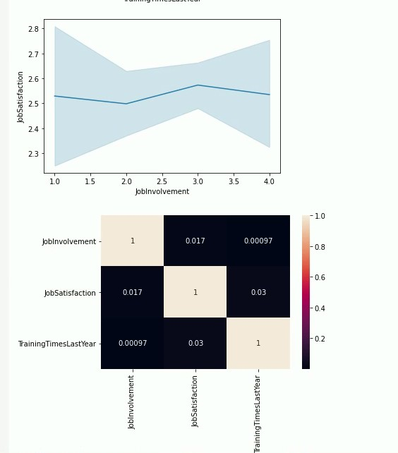
QUARTERLY PERFORMANCE
Notes:
Based on the provided correlation coefficients, it appears that there is a weak positive correlation between job satisfaction and training hours (correlation = 0.03), and a very weak positive correlation between job satisfaction and job involvement (correlation = 0.017).
A correlation coefficient ranges from -1 to +1, with 0 indicating no correlation, +1 indicating a perfect positive correlation, and -1 indicating a perfect negative correlation. In this case, both correlations are close to 0, suggesting a minimal linear relationship between the variables.
The correlation of 0.03 between job satisfaction and training hours implies that there is a slight tendency for individuals with higher job satisfaction to have slightly more training hours, but the relationship is not strong.
Similarly, the correlation of 0.017 between job satisfaction and job involvement suggests a weak positive association, indicating that individuals with higher job satisfaction may tend to have slightly higher levels of job involvement, but the relationship is not significant.
It's important to note that correlation coefficients only measure the linear relationship between variables and do not capture other potential factors or nonlinear relationships that may influence attrition. Therefore, while these correlations provide some insights, it is necessary to consider other factors and conduct further analysis to fully understand the relationship between job satisfaction, job involvement, and attrition.

Slide 5
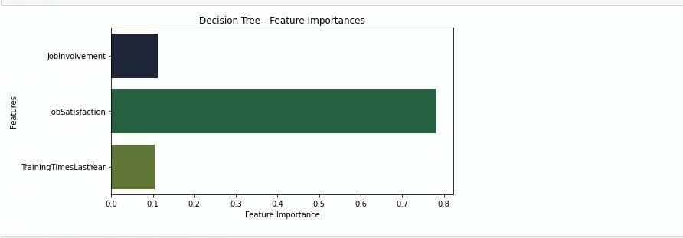
AREAS OF Interest
Notes:
The decision tree analysis can be a valuable tool to determine the importance of different features in predicting job involvement. In this particular case, the decision tree reveals that job satisfaction has the highest importance with a feature importance score of 0.8, indicating that it has a strong influence on job involvement. This suggests that employees with higher job satisfaction are more likely to exhibit higher levels of job involvement.
On the other hand, both job involvement and training have relatively lower feature importance scores of 0.1 each. This suggests that while job involvement and training contribute to the prediction of job involvement, their impact is relatively less significant compared to job satisfaction.
By considering the feature importance scores from the decision tree, organizations can focus their efforts on improving job satisfaction as a primary driver of job involvement. This may involve initiatives to enhance employee satisfaction through factors such as recognition programs, work-life balance, professional development opportunities, and fostering a positive work environment.
While job involvement and training are still relevant factors, their lower feature importance scores indicate that addressing job satisfaction may yield more substantial improvements in overall job involvement. It is important to note that feature importance scores are specific to the decision tree model and may vary in other models or datasets. Thus, additional analysis and exploration of the data are essential for a comprehensive understanding of the factors influencing job involvement.

Slide 6

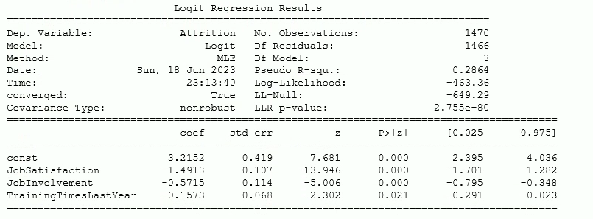
AREAS OF Interest
Logistic regression model created based on Job Involvement, Job Satisfaction, and Training hours
Notes:
Logistic regression provides valuable insights through its model output.
Coefficients for each variable indicate the direction and strength of their relationship with the outcome (e.g., attrition).
Significance tests, such as p-values, help determine the statistical significance of the relationships.
Additionally, classification reports provide information on precision, recall, F1-score, and accuracy, which assess the model's predictive performance.
The insights derived from the logistic regression model empower organizations to make informed decisions.
By understanding employees' preferences for direct engagement and valued leadership attributes, strategies can be developed to enhance employee engagement and satisfaction.
The data-driven approach offered by logistic regression enables organizations to align their practices with employee expectations and create a more productive and fulfilling work environment.
Based on the logistic regression model results, which include significant coefficients for the variables JobSatisfaction, JobInvolvement, and TrainingTimesLastYear, it indicates that these variables have an impact on the likelihood of an employee experiencing attrition in the company.
With this information, you can use the logistic regression model to make predictions and classify employees into categories of staying or experiencing attrition based on their JobSatisfaction, JobInvolvement, and TrainingTimesLastYear values.
The model's coefficients provide insights into the direction and magnitude of the effects of these variables on attrition. By considering these coefficients, you can assess which variables have a stronger influence on attrition. For example, a higher negative coefficient for JobSatisfaction suggests that lower job satisfaction is associated with a higher likelihood of attrition.

